Slide 1
Changes in semantical division of Synagoge am Anger

Slide 2
Changes in semantical division of CPMP (central part main part)

Slide 3
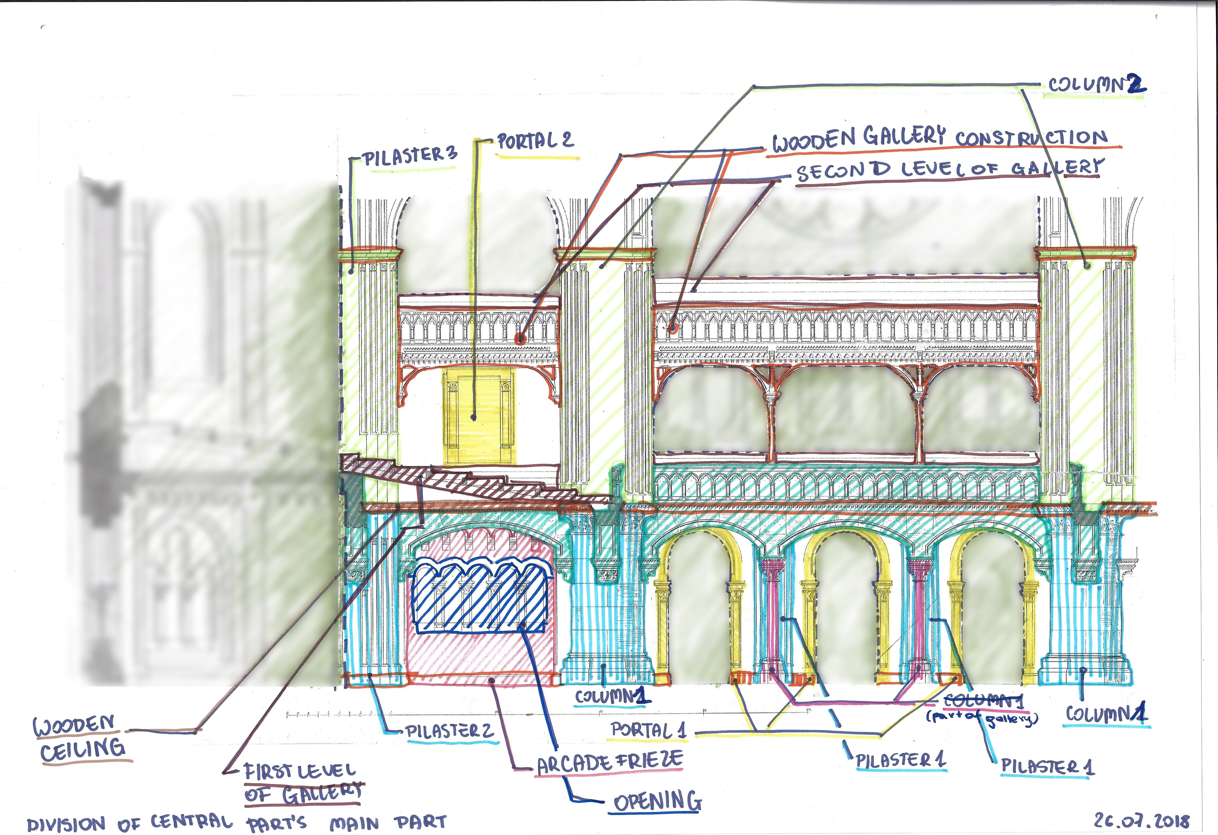
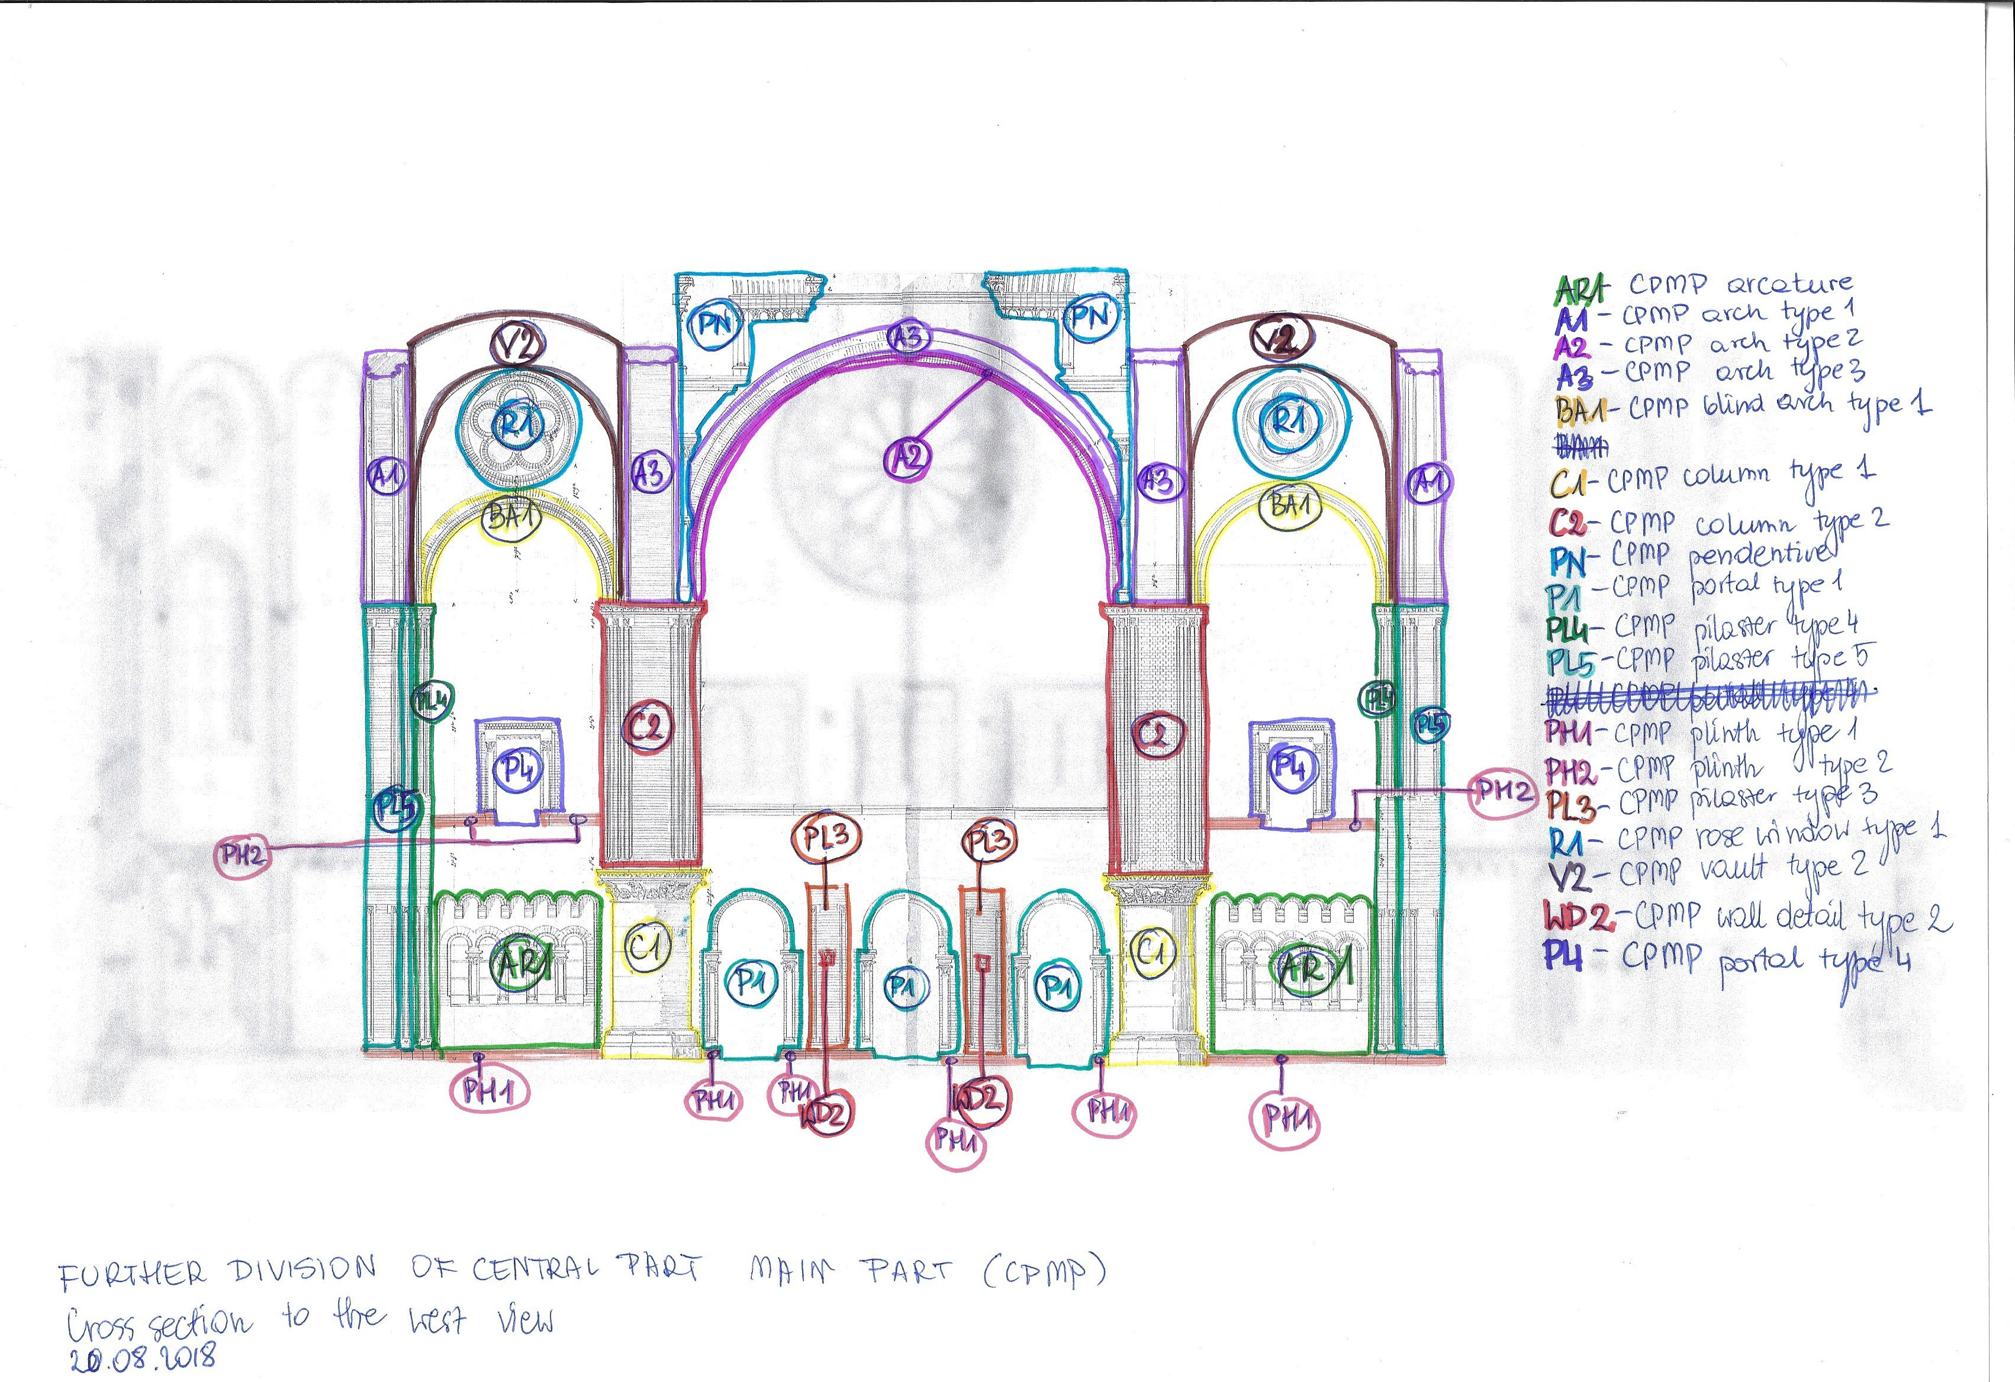
Changes in interior objects
Cross section to the west
OLD DIVISION
Source: Stadtarchiv Hannover, Nachlaß Oppler, Mappe 60, Blatt 16.
NEW DIVISION
Source: Stadtarchiv Hannover, Nachlaß Oppler, Mappe 60, Blatt 14.
Gallery is part of equipment, so new division doesn´t contain it.
Cornices on top of column and pilasters are part of them, they are not seperate elements
Arcade frieze and opening are one element – aracature
Order of object was different in modeling process:
Portal 2 is now Portal type 4;
Pilaster 1 is now Pilaster type 3;
Pilaster 2 and 3 don`t have horizontal division and they are Pilaster type 4 and Pilaster type 5 with vertical division
5) There are a lot of new objects, which were missed in first division

Slide 4
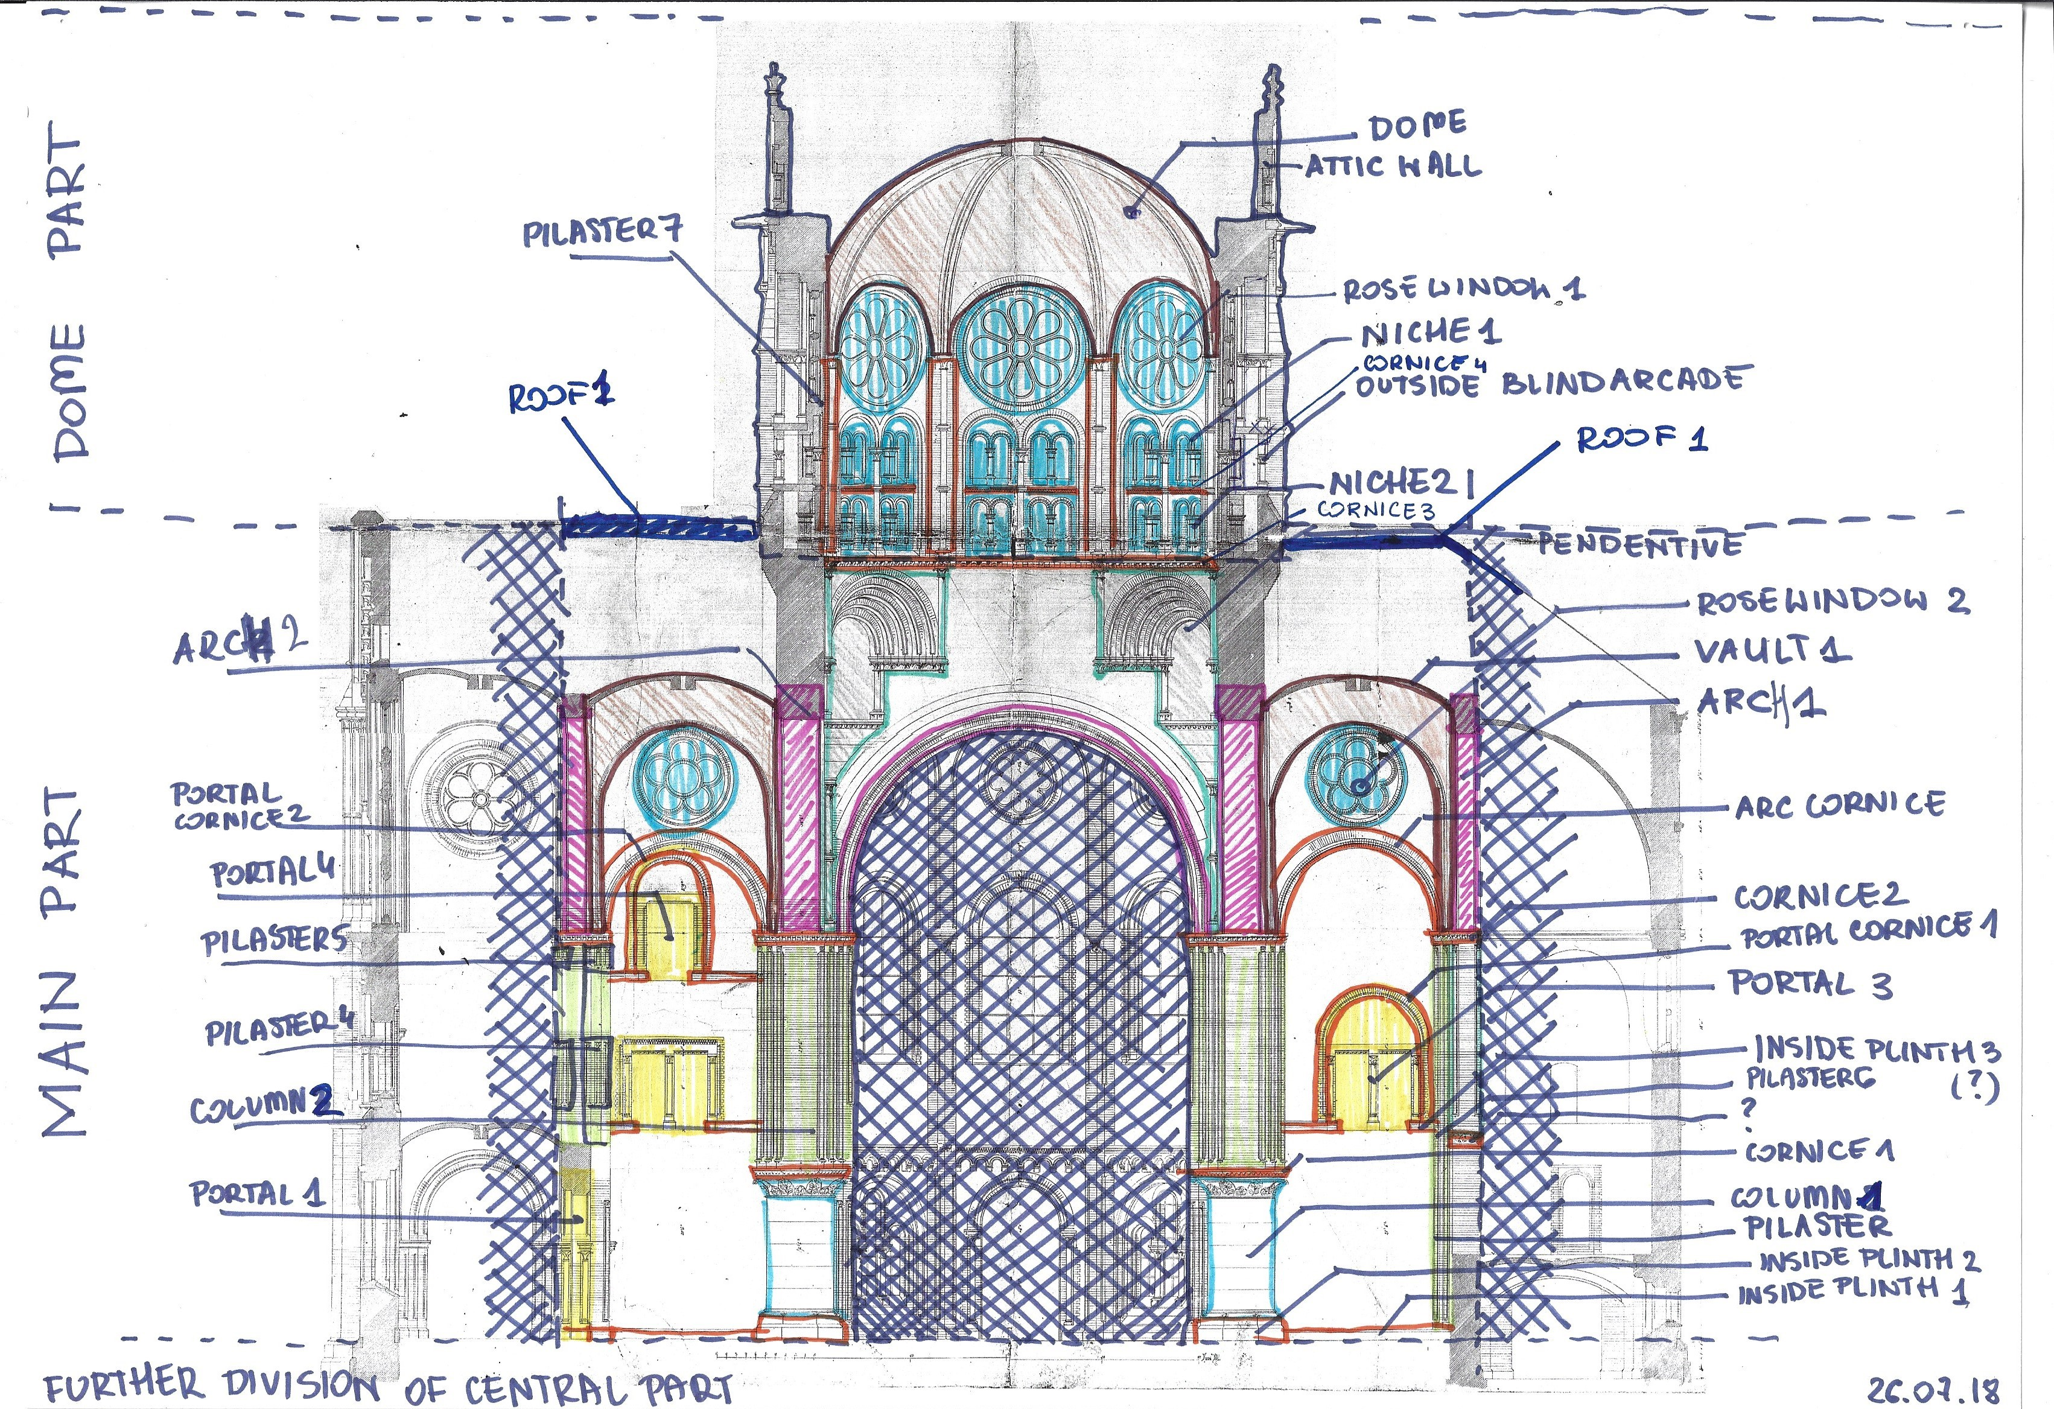
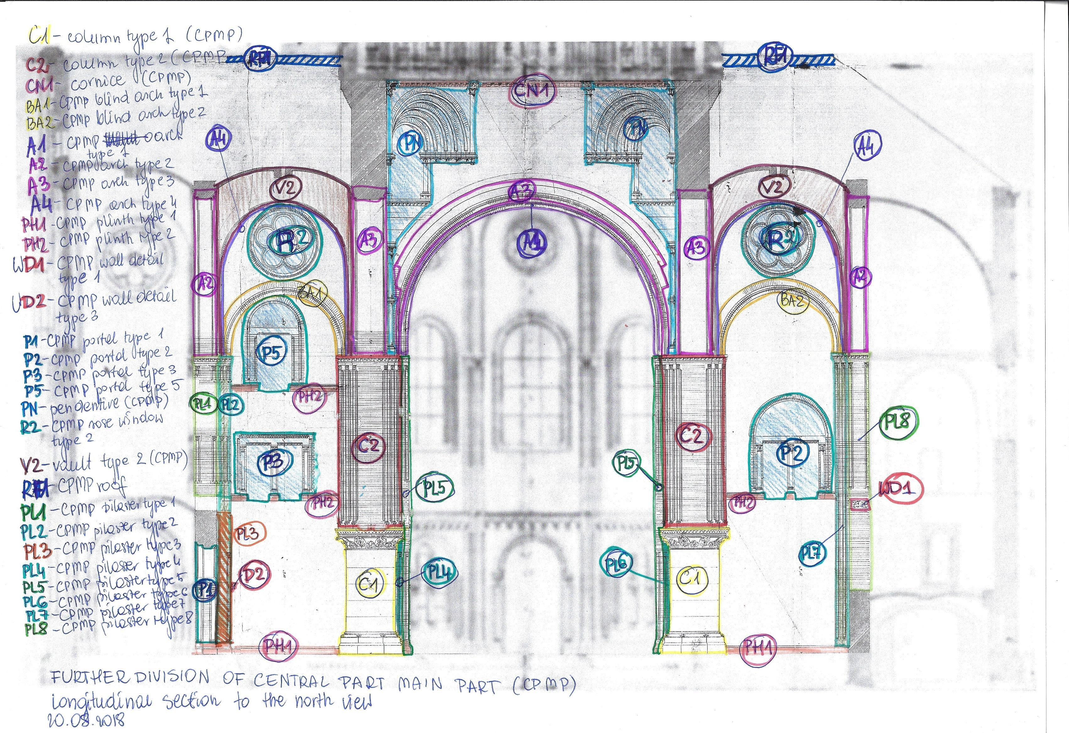
Changes in interior objects
Longitudinal section to the north
OLD DIVISION
Source: Stadtarchiv Hannover, Nachlaß Oppler, Mappe 60, Blatt 15.
NEW DIVISION
Source: Stadtarchiv Hannover, Nachlaß Oppler, Mappe 60, Blatt 15.
1) Some elements were created now as one object:
inside plinth 1, column 1 and cornice 1 are now column type 1
column 2 and cornice are now column type 2
inside plinth 3 portal cornice 1 and portal 3 are now portal type 2
portal cornice 2 and portal 4 are now portal type 5
2) Changes in names of elements
arc cornice is now blind arch
inside plinth 1 is now plinth type 1
3) New elements, which were missed in first division
portal type 3
wall detail type 1
Pilaster type 8
4) Different order of elements:
portal 3 is now portal type 2
portal 4 is now portal type 5
vault 1 is now vault type 2
pilaster 6 is now pilaster type 7
arch 1 is now arch type 2
arch 2 is now arch type 3
5) Different division of elements
Pilaster 4 and 5 are not just columns, they are parts of elements pilaster type 1 and pilaster type2

Slide 5
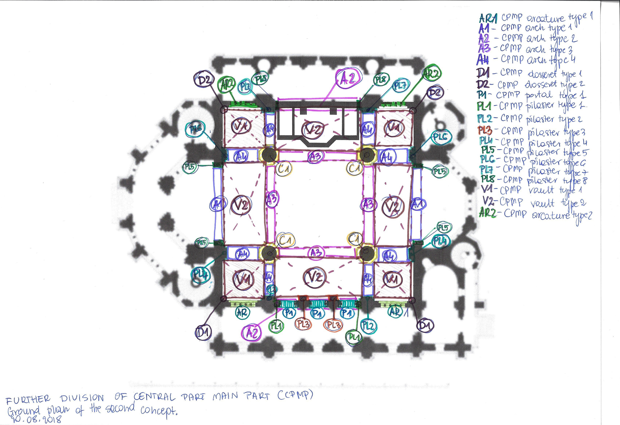
Changes in interior objects
Longitudinal section to the north
Old division based only on sections and some elements were appeared while process of modeling. These objects were marked on a plan. Here is a list of new elements:
arcature type 2
dosseret type 1
dosseret type 2
pilaster type 6
pilaster type 7
pilaster type 8
vault type 2
NEW DIVISION
Source: Stadtarchiv Hannover, Nachlaß Oppler, Mappe 60, Blatt 09.

Slide 6
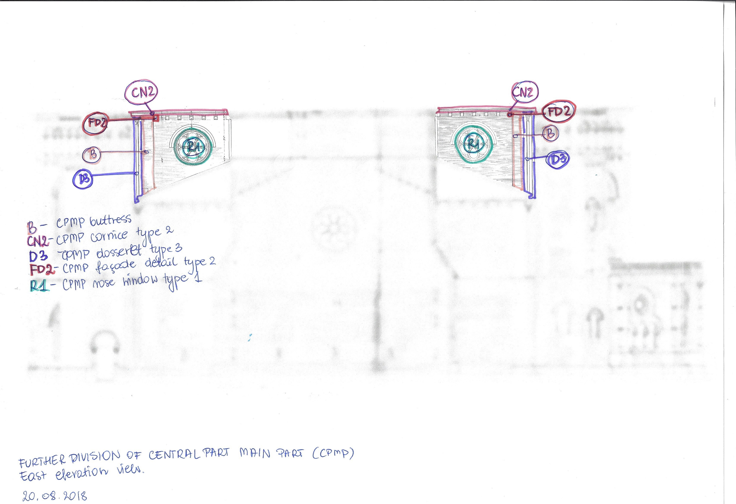
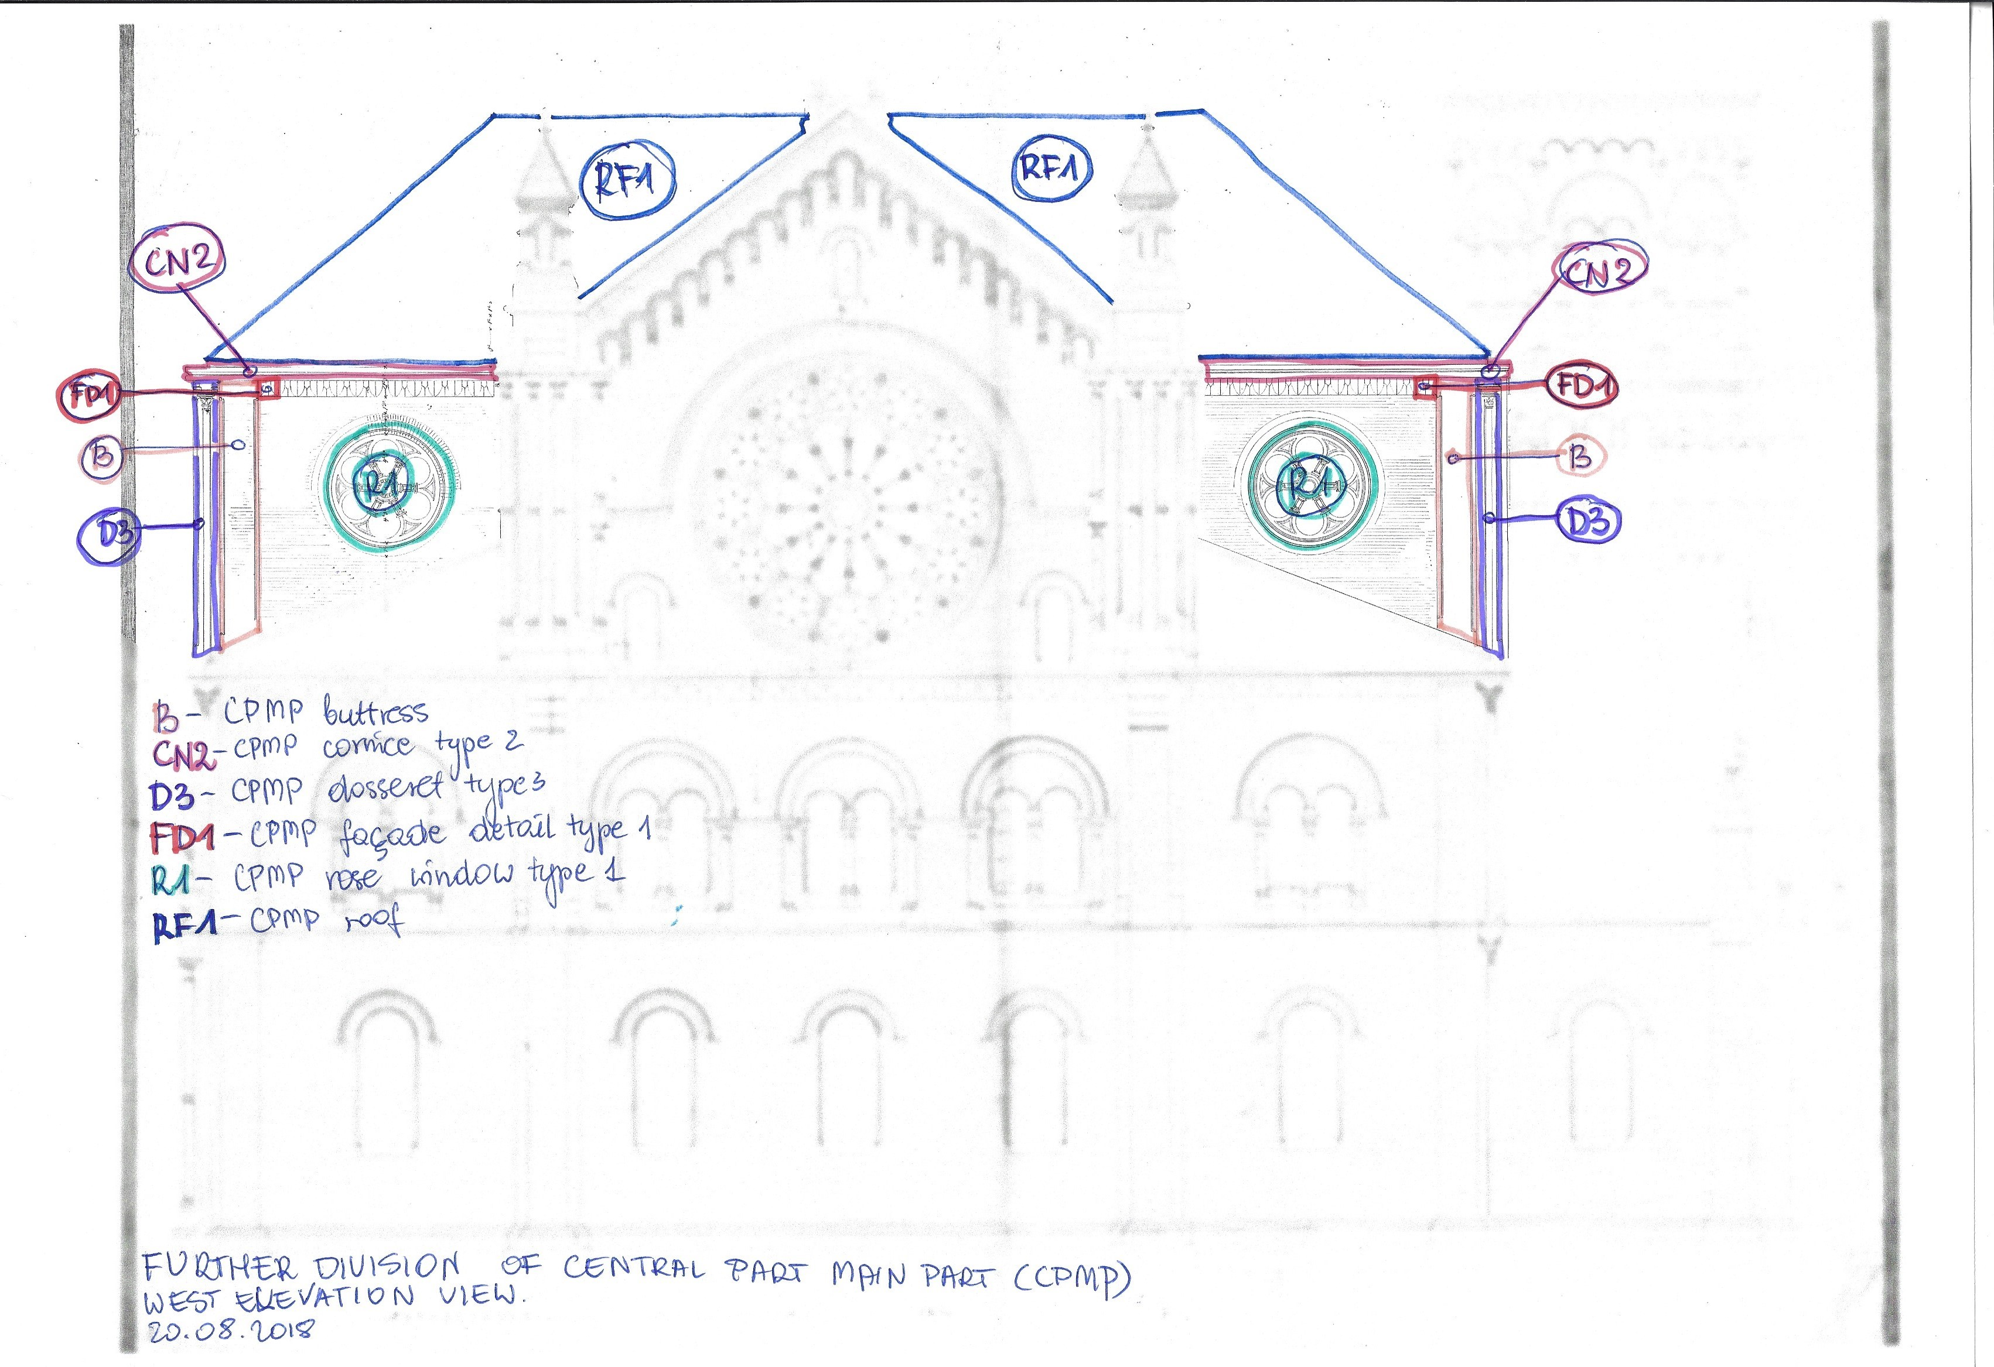
External objects
Western and eastern elevation
NEW DIVISION
Eastern elevation
Source: Stadtarchiv Hannover, Nachlaß Oppler, Mappe 60, Blatt 11.
NEW DIVISION
Western elevation
Source: Stadtarchiv Hannover, Nachlaß Oppler, Mappe 60, Blatt 12.
Current model doesn´t contain outside elements and that`s why they weren`t in first division. Here is a list of new objects from outside:
buttress
cornice type 2
dosseret type 3
façade detail type 1
façade detail type 2

Slide 7
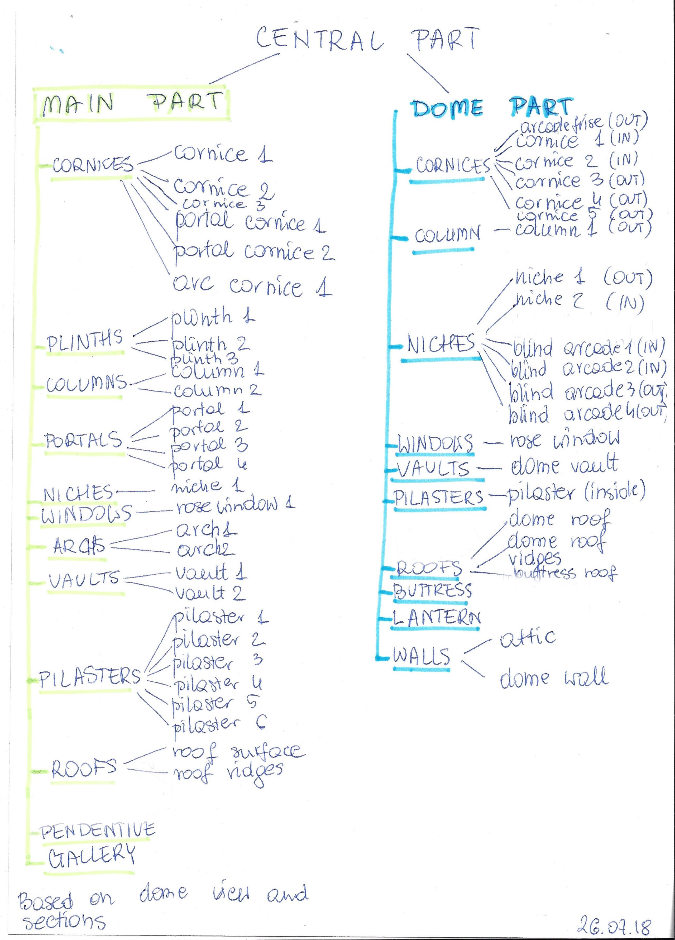
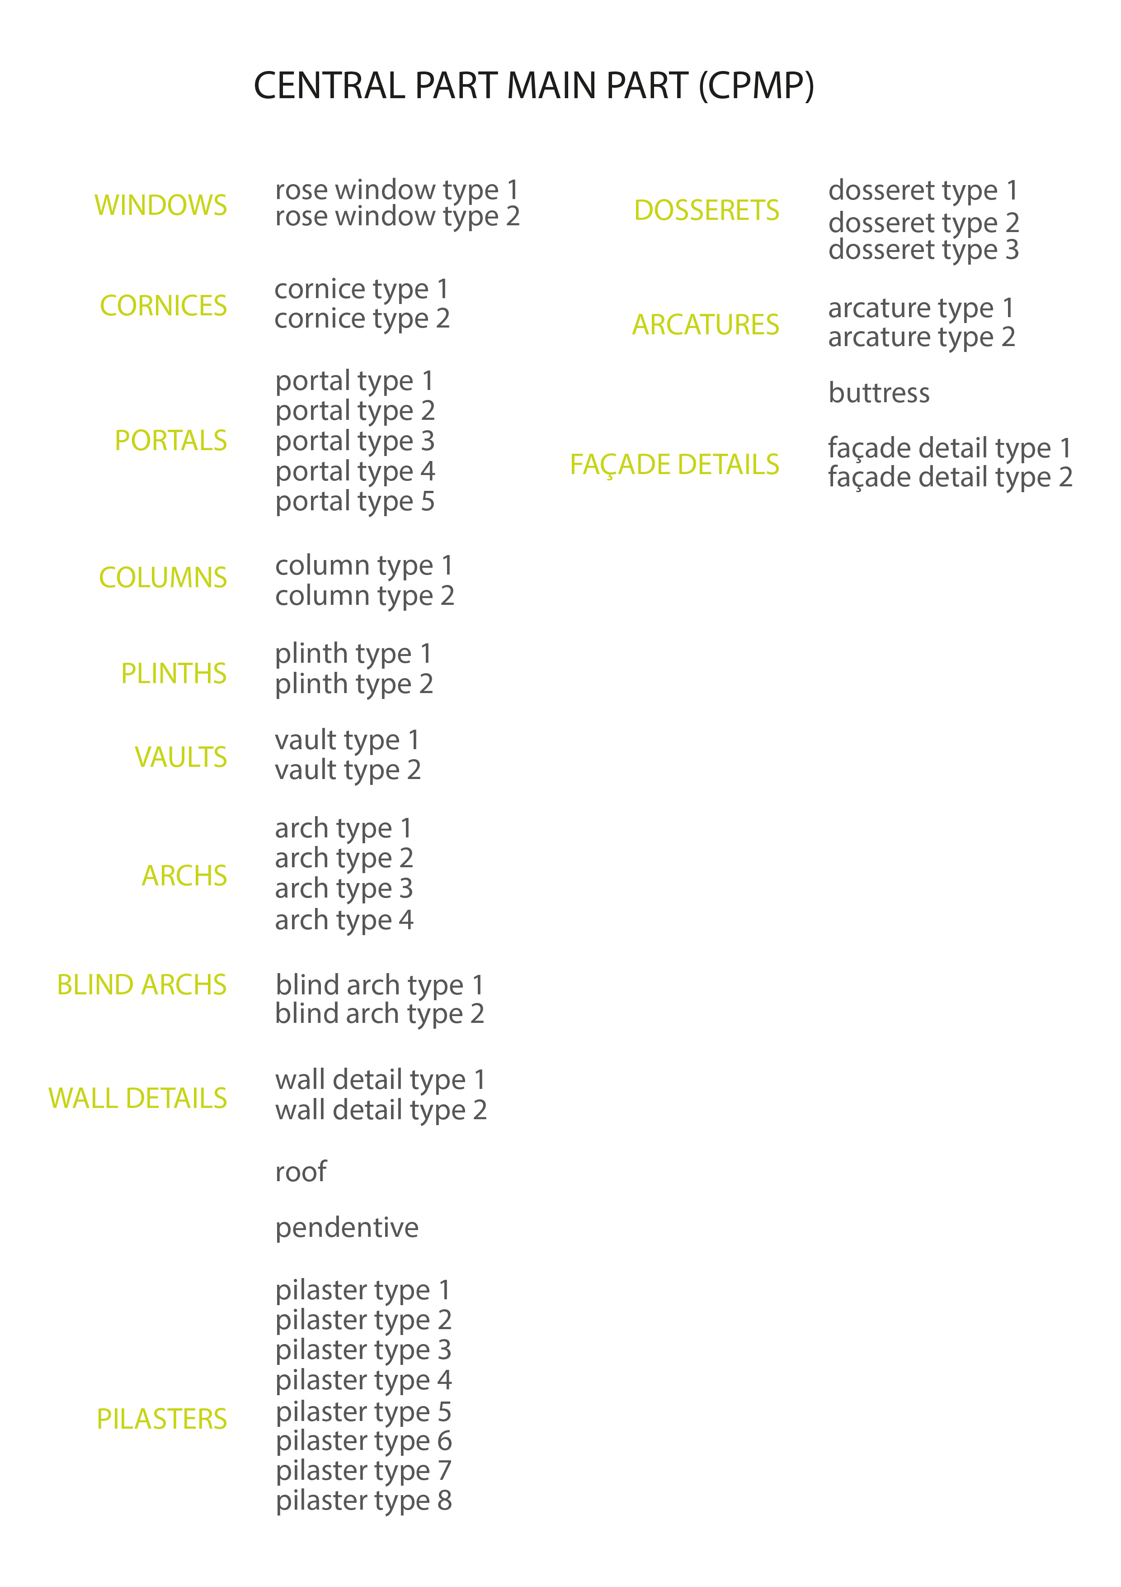
CPMP semantical division
List of objects - comparison
OLD SEMANTICAL DIVISION
NEW SEMANTICAL DIVISON

Slide 8
Changes in semantical division of WPMP (western part main part)
Old division is a first trial of dividing WPMP (western part main part), that was based on only one drawing, some time before the beginning of the process of 3d reconstructing of the Synagogue. During the 3d reconstruction and further analysis of historical sources, the need of distinguishing more objects appeared, so the new division was made.

Slide 9
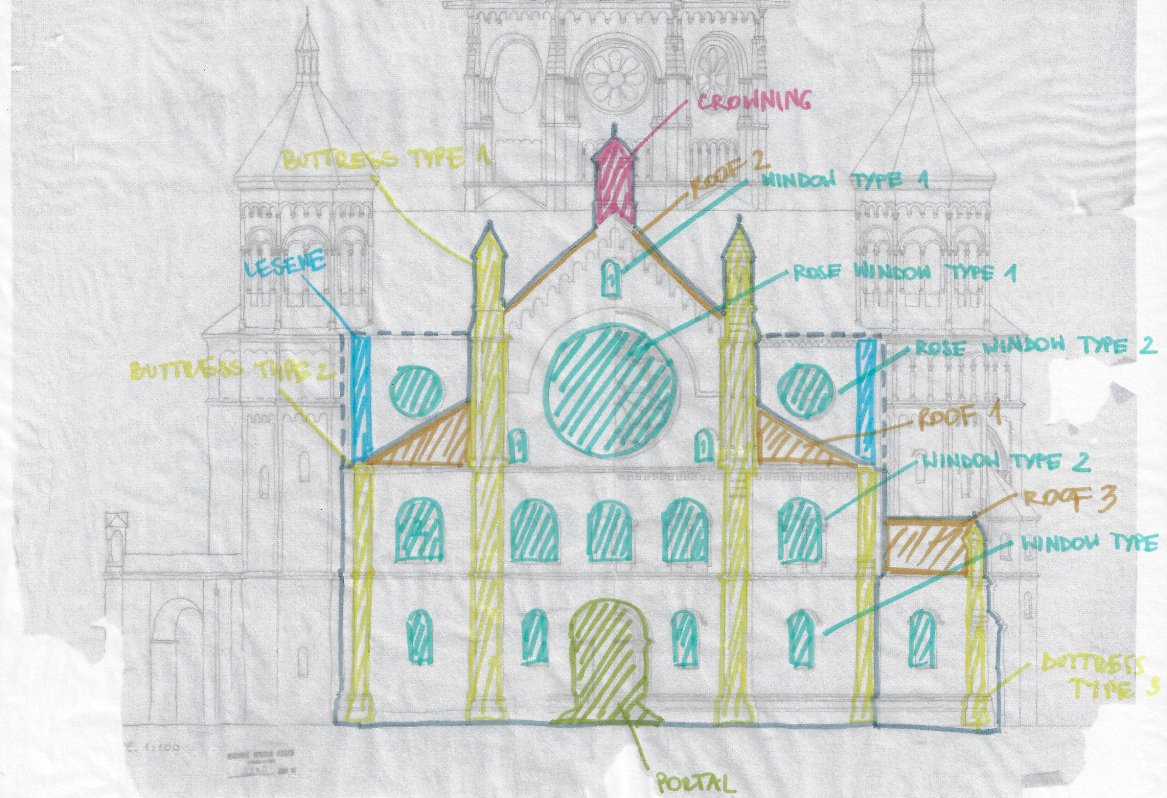
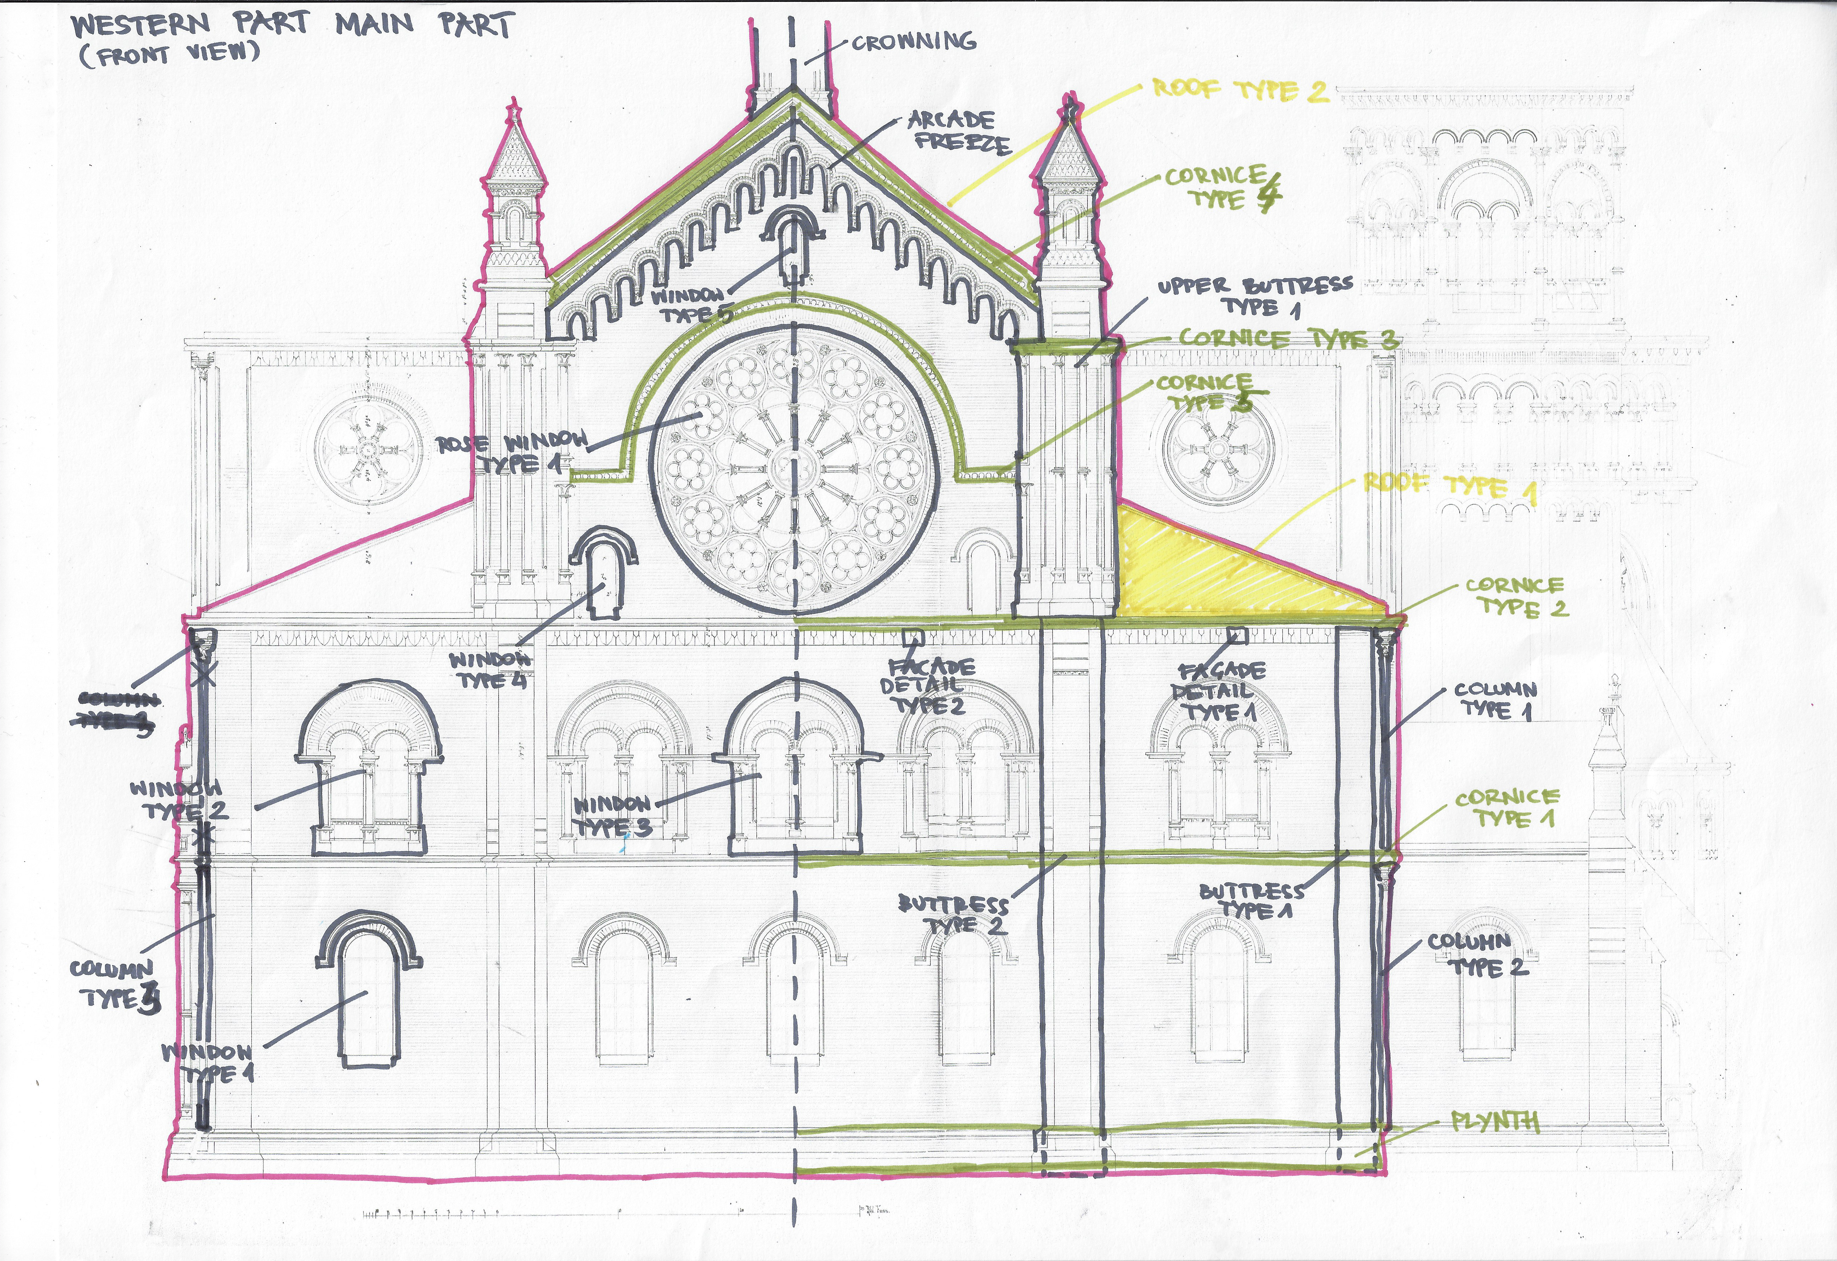
Changes in semantical division
Old division vs new division
OLD DIVISION
Western elevation, source: Muzeum Architektury we Wrocławiu, Archiwum Budowlane Miasta Wrocławia (TP 246 syg 6122)
NEW DIVISION
Western elevation, source: Stadtarchiv Hannover (StadtAH 3 NL 547 Oppler Synagoge Breslau 60 12)
Upper, back walls should not belong to WPMP, but to CPMP
Plinth, cornices, façade details and façade columns should be distinguished as well
Window type 2 on the old division is actually two different types of the windows
Buttress type 1 on the old division consist of two parts, which had to be distinguished during 3d reconstruction process
Portal distinguished on the old division should not be reconstructed, as it is from the later rebuilding of the synagogue
Names of objects and their numbers were changed

Slide 10
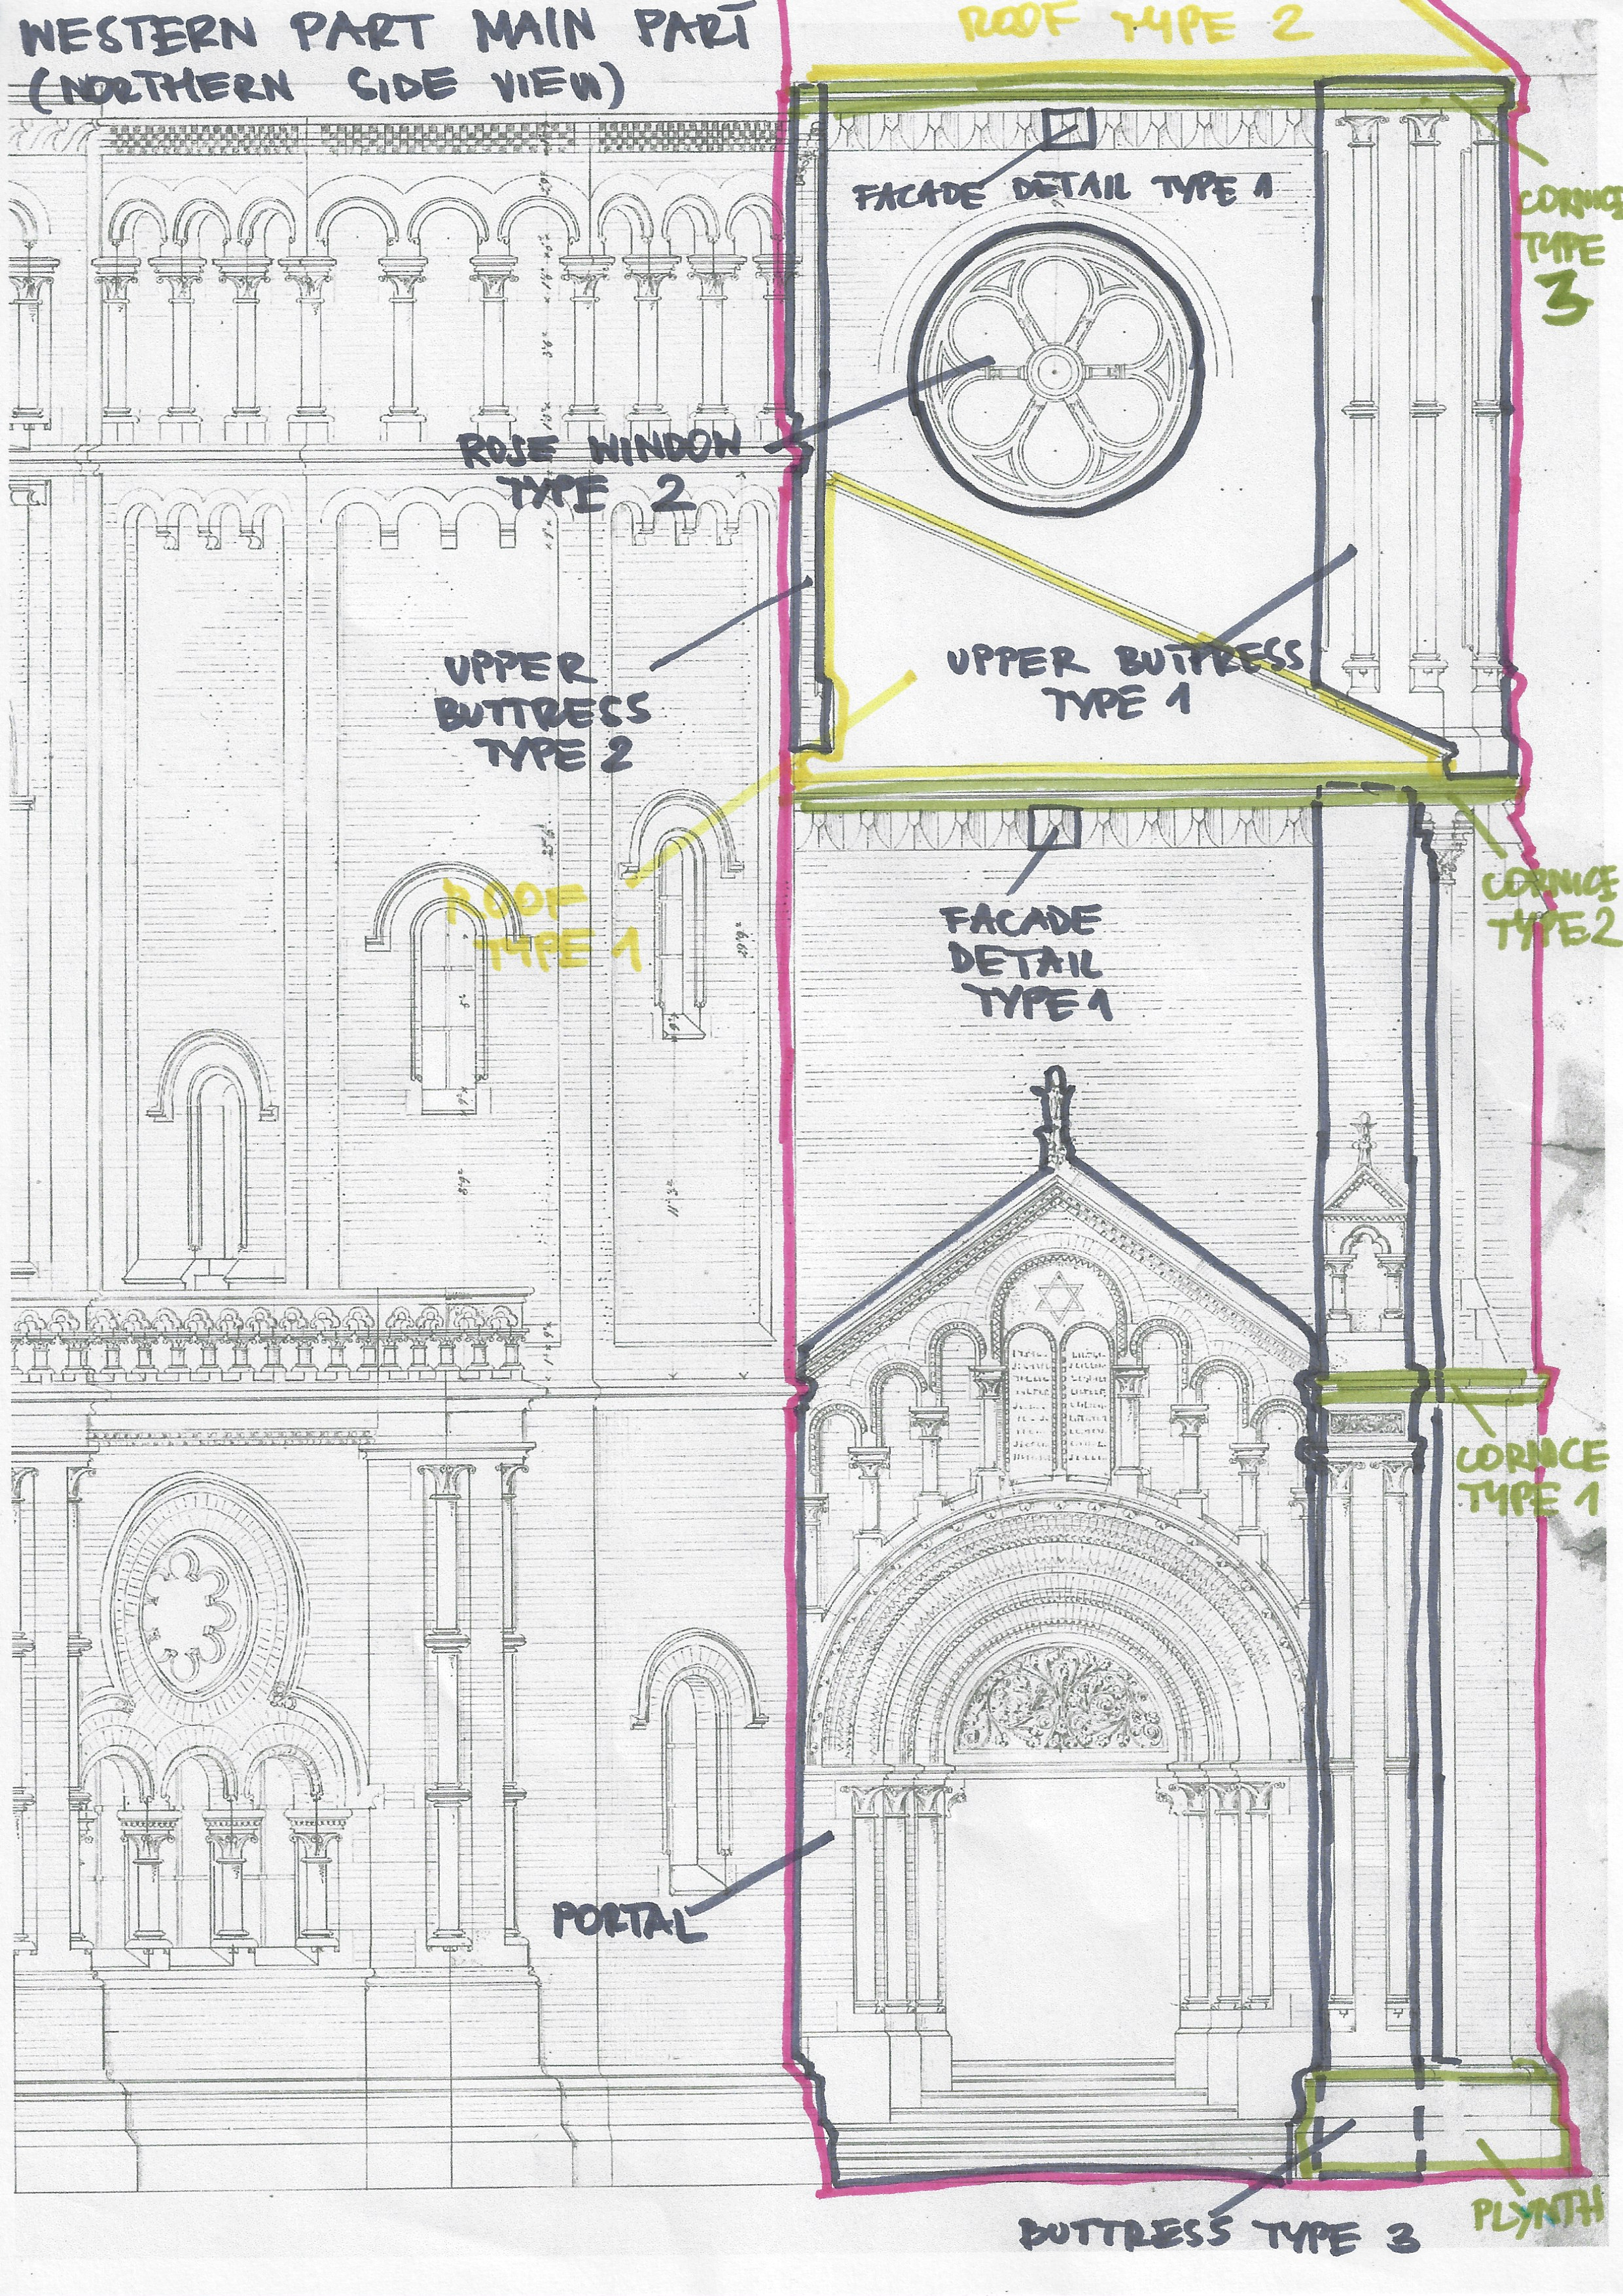
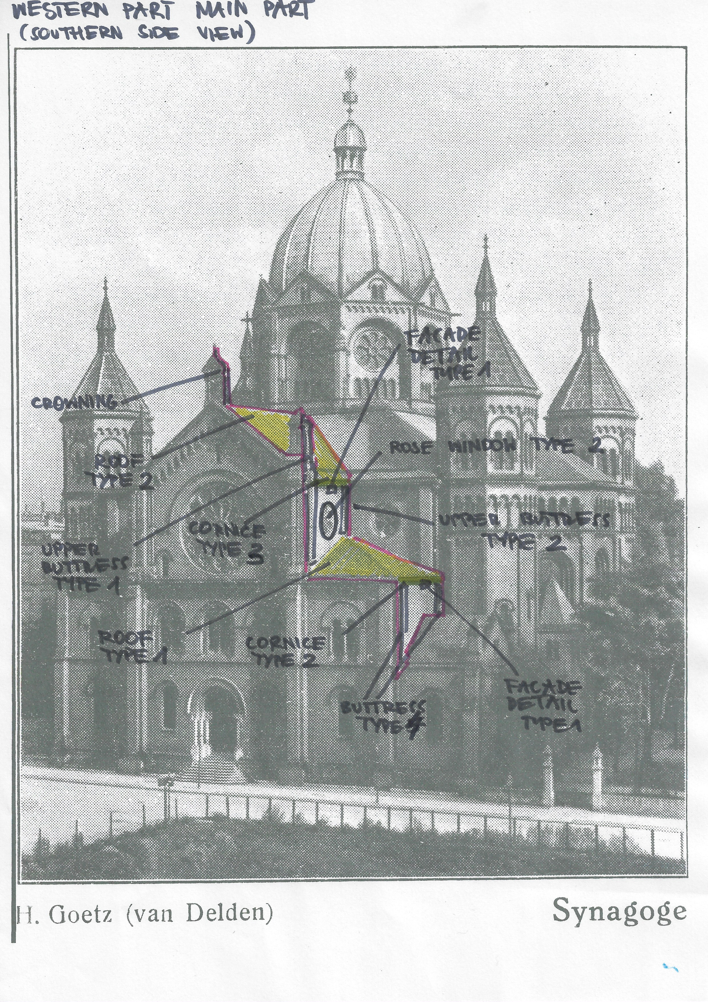
Changes in semantical division
New division – additional drawings
Portal, smaller rose window and three types of buttresses were not distinguished before, as they were not seen on the western elevation view
NEW DIVISION
Northern elevation, source: Stadtarchiv Hannover (StadtAH 3 NL 547 Oppler Synagoge Breslau 60 10)
NEW DIVISION
Photo depicting western and southern façade, source: private collection of Maciej Łagiewski

Slide 11
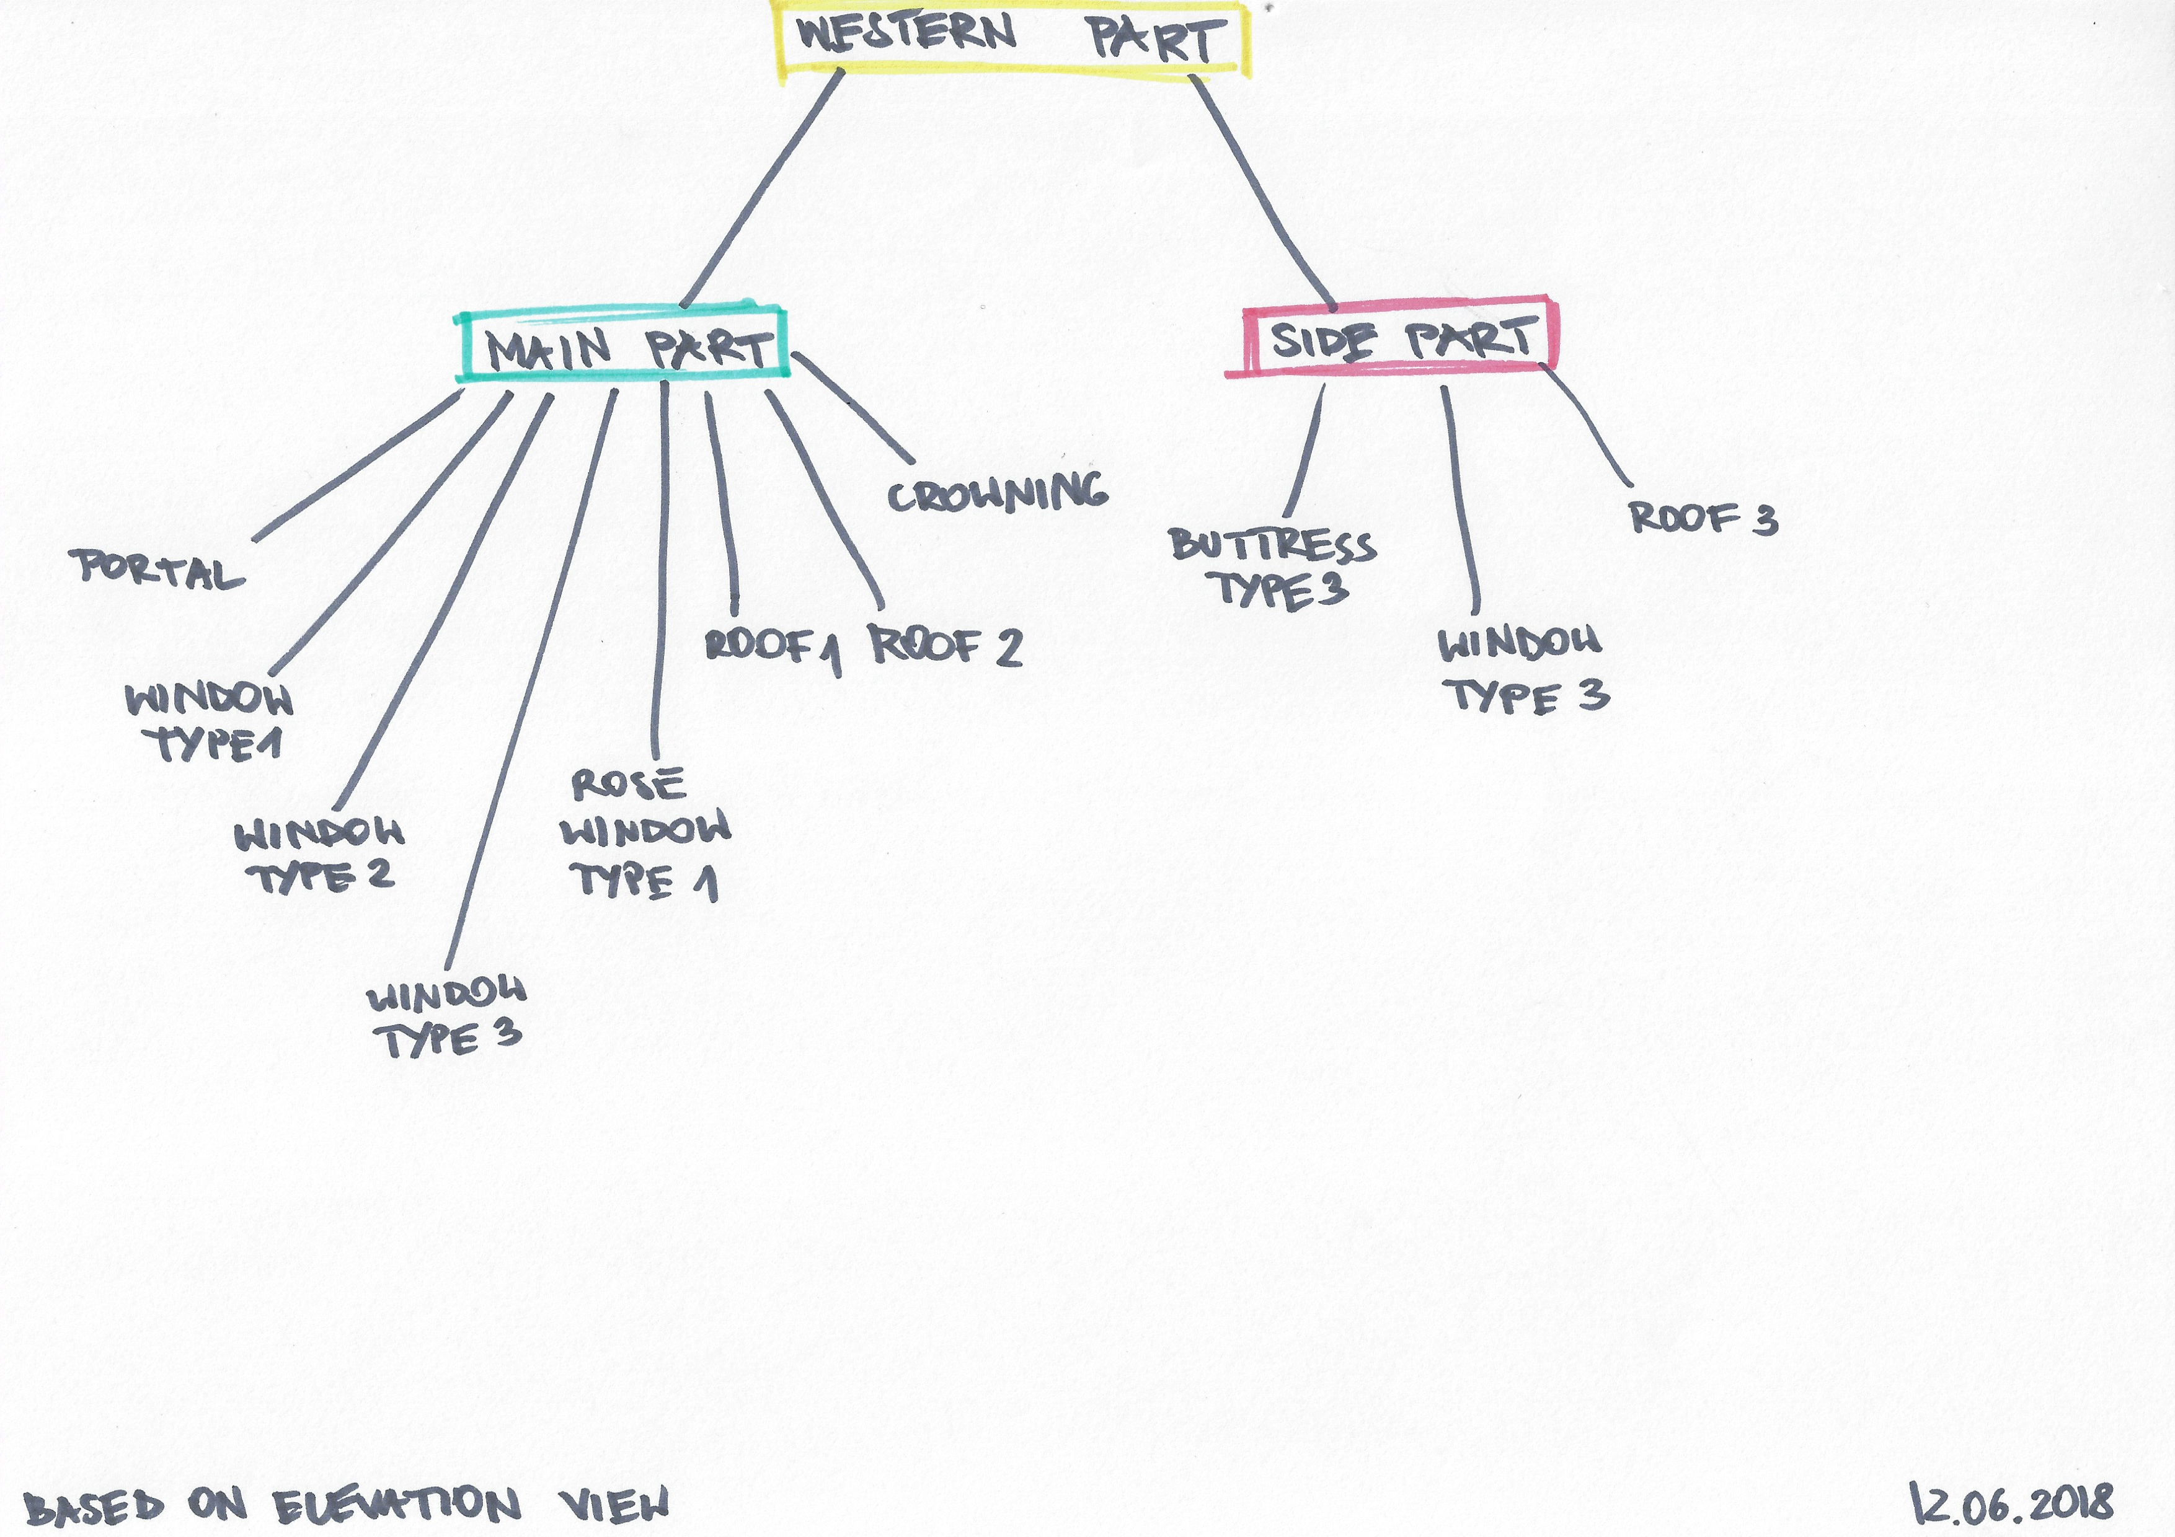
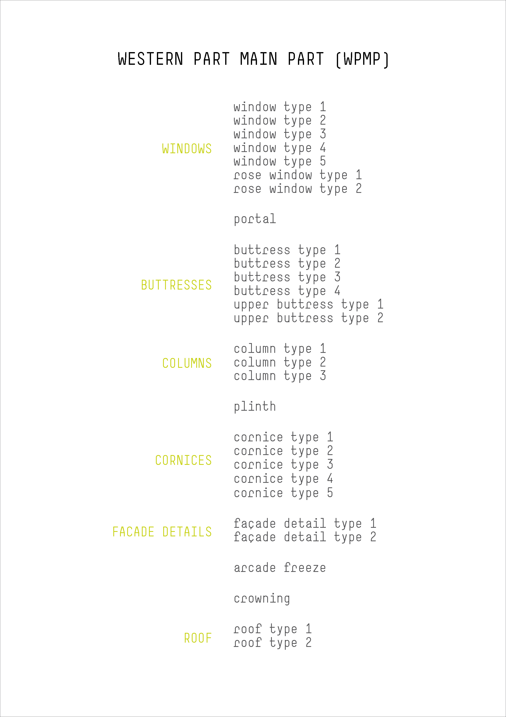
Changes in semantical hierarchy
Hierarchy
OLD SEMANTICAL DIVISION
NEW SEMANTICAL DIVISON

